Slide 1

SOIL MONITORING SYSTEM-AGRICULTURAL THEME
PRESENTED BY:
Maha Al-Khars ID 39963
This Photo by Unknown author is licensed under CC BY-SA.

Slide 2

INTRODUCTION
Agriculture is the backbone of any economy given that food is basic need in each household.
The concept behind Automatic irrigation not only touches my core value of innovation but also the U.N.D.P sustainable goals i.e.,
Industry, Innovation & Infrastructure.
Responsible production & consumption.
Zero Hunger.
This Photo by Unknown author is licensed under CC BY-SA-NC.
Notes:
The motivation of this project comes from a deep passion to assist in the making sustainable technologies that impact the society.
Additionally it turns ON an LED in case of abnormal/Wet Soil state.
Other fundamental goals include its simulation prototype using computational tools; Circuit Design & Simulation software in addition to developing other techniques such as L.C.D for the alphanumeric display of monitored soil quantities.

Slide 3

PROJECT OVERVIEW
Project’s prototype plays a key role in the development of intelligent systems by delivering sustainable system that detects current soil state and activates flow of water.
It indirectly saves electricity consumption by remaining idle at normal state.
The high level objective of this agriculture-related project is to prototype a system that detects and monitors the soil state and triggers a water flow mechanism.

Slide 4
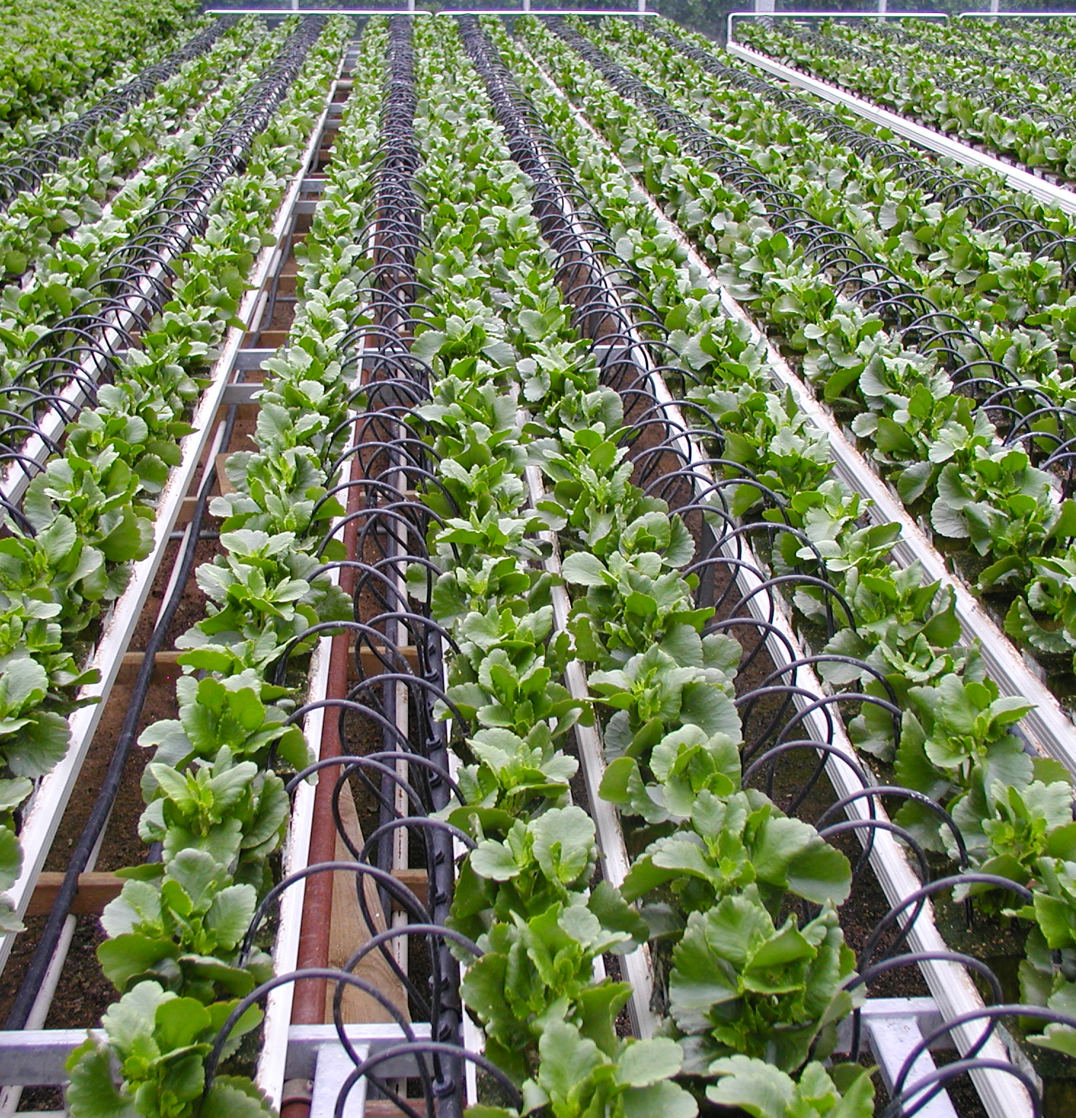
POSSIBLE METHODOLOGIES
Circuit topologies related to the soil monitoring system include.
AN INTELLIGENT IRRIGATION SYSTEM USING THE INTERNET OF THINGS APPROACH (Rajkumar, Abinaya and Kumar, 2017).
AUTOMATED IRRIGATION SYSTEM USING GPRS MODULES AND WIRELESS SENSOR NETWORKS (Gutierrez et al., 2013).
SMART IRRIGATION SYSTEM USING EMBEDDED SYSTEMS (Namala, et al., 2013).
SOIL MONITORING USING IOT, ARDUINO AND NEURAL NETWORKS (Athani, et al., 2013).
This Photo by Unknown author is licensed under CC BY-NC.

Slide 5

DECISION MATRIX FOR THESE SOLUTIONS
The decision matrix below helps in coming up with the most appropriate approach to solving the water irrigation system.
Key elements in the decision-making include;
Schedule- Prototype development time.
Extensibility – Weather Forecasting abilities.
Maintanability - Irrigates crops with adequate water
Sustaianability - Additional mechanisms for minimizing electricity consumption
Interoperablity - Web functionality that controls the systems from remote locations
Usability- Water Conservation
This Photo by Unknown author is licensed under CC BY-SA.
Notes:
Scores
Solution 1 : 31
Solution 2: 33
Solution 3: 30
Solution 4: 29

Slide 6
PROPOSED SOLUTION
Arduino Uno R3- main component used as a microcontroller used because of its cheaper price compared to Raspberry Pi in solution 3.
Moisture sensor; detects soil states using analog and digital inputs. The analog gives a varying voltage from 0 to 255 based on the soil moisture.
Temperature and Humidity sensors included in propose solution; detects other environmental parameters.
Pump or Motor operating on L293D motor driver IC with internal clamp diodes for protection and in-built H-bridges for changing anticlockwise and clockwise movements.

Slide 7

FUTURE MODIFICATIONS
Weather Forecasting and Image processing but can come later with Raspberry Pi B+ acting as the receiver and Arduino in the M.V.P acting as transmitter.
Neural Networks; the system supports acidity, salinity assessments in the soil for a future modification.

Slide 8
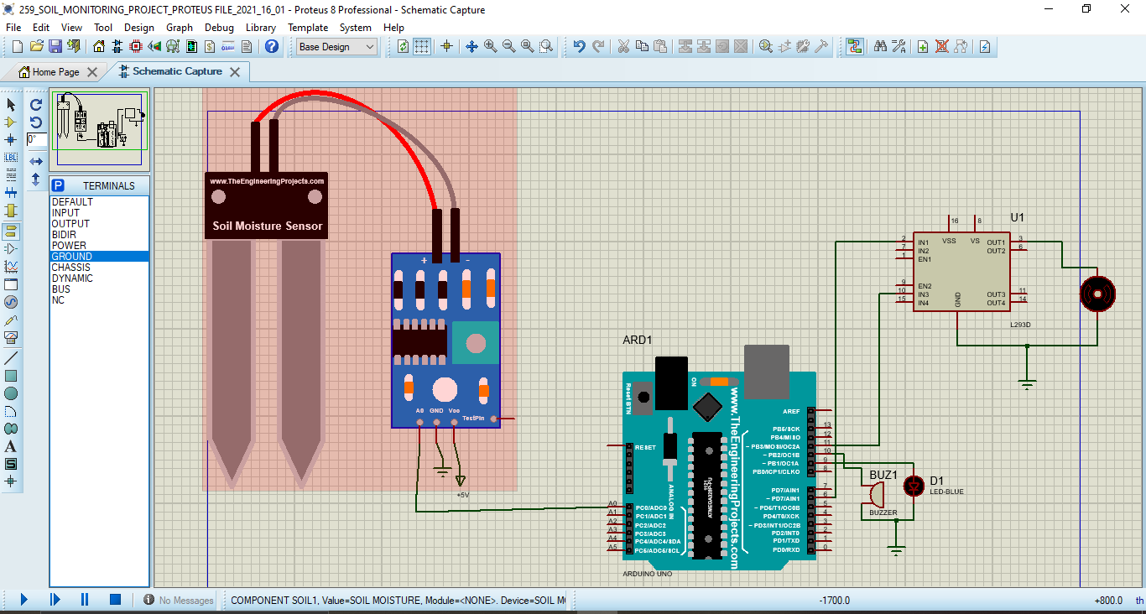
APPENDIX 1: PROTEUS SIMULATIONS

Slide 9
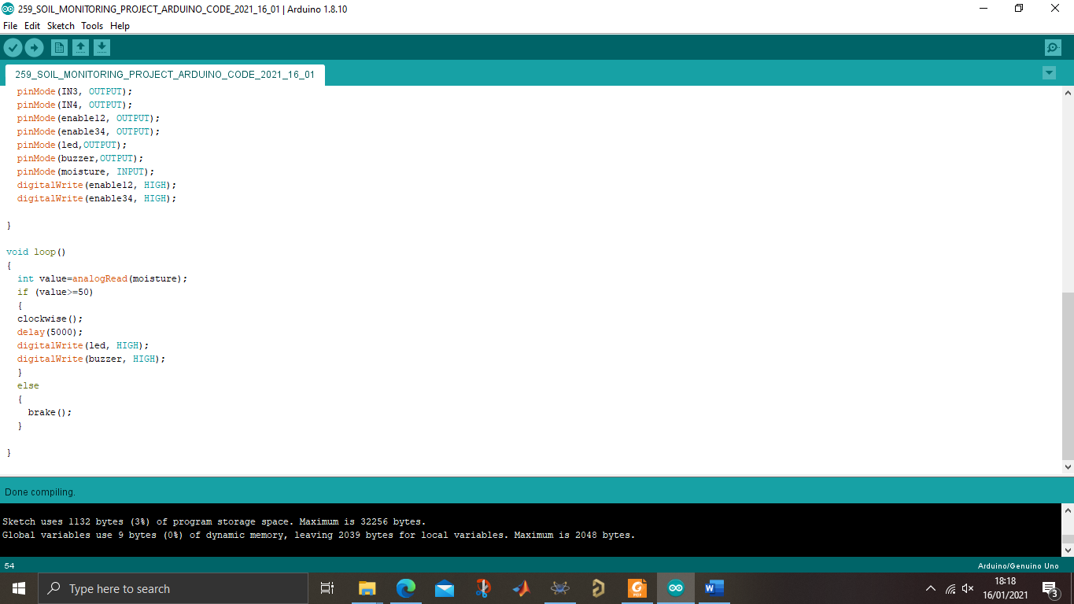
APPENDIX 2: ARDUINO CODE

Slide 10
REFERENCES
Athani, S., Tejeshwar, C. H., Patil, M. M., Patil, P., & Kulkarni, R. (2017, February). Soil moisture monitoring using IoT enabled Arduino sensors with neural networks for improving soil management for farmers and predict seasonal rainfall for planning future harvest in North Karnataka—India. In 2017 International Conference on I-SMAC (IoT in Social, Mobile, Analytics and Cloud)(I-SMAC) (pp. 43-48). IEEE.
Gutiérrez, J., Villa-Medina, J. F., Nieto-Garibay, A., & Porta-Gándara, M. Á. (2013). Automated irrigation system using a wireless sensor network and GPRS module. IEEE transactions on instrumentation and measurement, 63(1), 166-176.
Namala, K. K., AV, K. K. P., Math, A., Kumari, A., & Kulkarni, S. (2016, December). Smart irrigation with embedded system. In 2016 IEEE Bombay Section Symposium (IBSS) (pp. 1-5). IEEE.
Rajkumar, M. N., Abinaya, S., & Kumar, V. V. (2017, March). Intelligent irrigation system—An IOT based approach. In 2017 International Conference on Innovations in Green Energy and Healthcare Technologies (IGEHT) (pp. 1-5). IEEE.

Slide 11

THANK YOU
FOR YOUR PRECIOUS TIME

